Slide 1
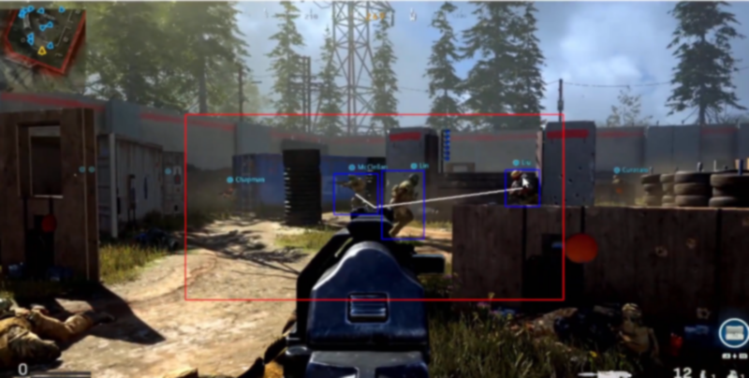
REAL-TIME ANALYSIS FOR DETECTING BOT BEHAVIOR IN ONLINE GAMES
CENG 3544, NETWORK AND SECURITY

Slide 2

ABSTRACT
In Online games cheating is widespread. Even though precautions are taken some massively multiplayer online role-playing games(MMORPG) does not strictly prevent real-money trading. Primarily for this reason people tend to cheat in such games. One of most popular method is using game bots.

Slide 3








Slide 4
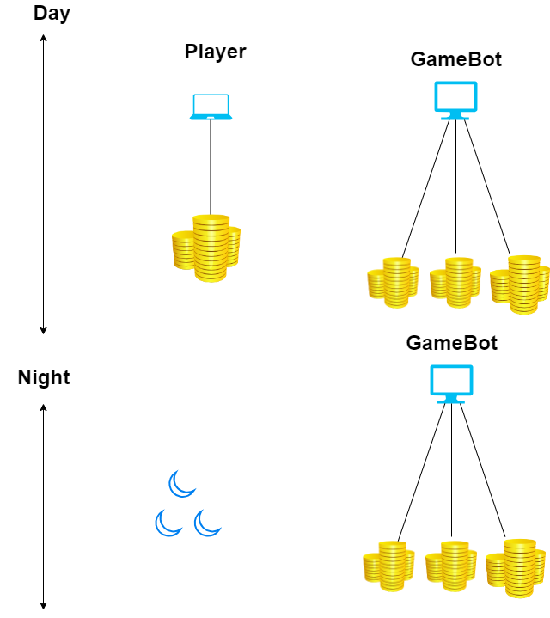
GAME BOT VS HUMAN

Slide 5

SOLUTION
One of the solution that is being used for this problem is bot detection methods.
There are couple ways to detect bot behaviour.
Our solution is real-time analysis.

Slide 6
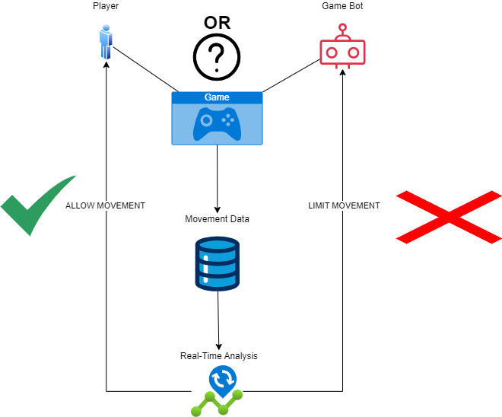
HOW ?

Slide 7

DETAILS
We keep track of character’s movements.(Yaw)
Then evaluate them based on anomaly detection algorithms.
If an anomaly detected based on this algorithm we restrict the movement of character.
Then display a pop-up screen for player to resolve(if there is a player to resolve of course)
If verified being human then player continue playing.

Slide 8

VARIABLES
There are three variables to take account of determining if there is a bot behavior or not. These are:
Movement Log Interval
Consecutive Count
Anomaly Count

Slide 9
DEFINITONS
Movement Log Interval:This variable determines how often we will log of the movements ,setting it 0.5 means every 0.5 seconds it will give.
Consecutive Count: Number of consecutived yaw value between timestamps.
Anomaly Count: Anomaly count is the list of consecutive counts more than 5. If we have a sequence of consecutive counts more than 5 we add anomaly count to 1.

Slide 10
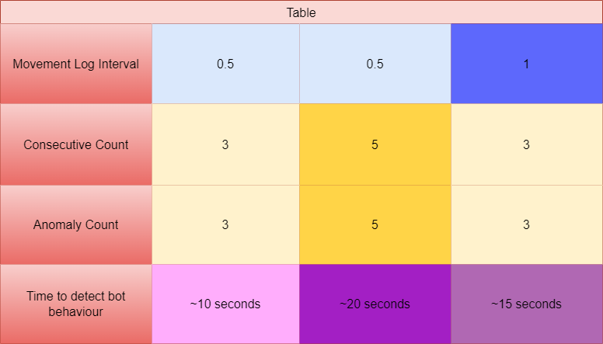
TABLE

Slide 11

CONCLUSION
In this study we benefited from couple researches and to be able to implement this game bot detection method.
Our real-time analysis method is not well-suited for some games that have complicated movement but it can be effective most of the games.
Taking account of other movement values will improve this method but might cause some performance problems.

Slide 12

THANK YOU!
QUESTIONS ?

